Slide 1

E-Commerce Olist Store Analysis
Project Requirements, Analysis & Final Dashboard

Slide 2
Index
Index
Introduction
KPI- visuals Recommendations
All dashboards
Overall achievements and Key Findings
SQL queries
Conclusion
Summary
Thank you

Slide 3
Introduction
This project focuses on analyzing e-commerce customer, order, payment, product, and delivery data.
The objective is to identify business trends, customer satisfaction patterns, payment preferences, and delivery performance.
We analyzed the data using SQL, Excel, Power BI, and Tableau.
The analysis converts raw data into meaningful insights and interactive dashboards to support better business decisions.
This project is based on e-commerce data analysis. Our main objective was to understand customer behavior, payment patterns, delivery performance, and customer satisfaction.
Finally, we converted the raw data into meaningful business insights that can help in better decision-making

Slide 4
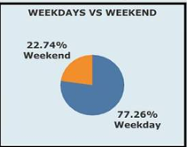
Payment Behavior: Weekday vs Weekend
Key Insights
Weekday: Credit Card ₹9.53M | Boleto ₹2.37M | Debit Card ₹0.17M | Voucher ₹0.30M
Weekend: Credit Card ₹3.01M | Debit Card ₹0.05M | Voucher ₹0.08M
Credit Card dominates both periods — opportunity for targeted payment promotions

Slide 5
5-Star Credit Card Orders: 43,938
Largest Segment
Strong Satisfaction
Gaps to Investigate
5-star reviews represent the single biggest review-score segment in the entire dataset.
Indicates consistently high satisfaction among credit card customers across transactions.
Lower review scores warrant deeper investigation into service quality and delivery shortfalls.

Slide 6
Pet Shop Delivery Performance
Delivery Metrics
The Pet Shop category recorded an average delivery time of 11.02 days — a critical benchmark for this segment.
Speed = Satisfaction
Faster Delivery
Delivery speed directly correlates with customer review scores.
Shorter delivery windows consistently produce higher satisfaction ratings.

Slide 7
São Paulo Market Snapshot
153
108
45
Avg Payment Value
Avg Product Price
Payment Premium
Average payment value per order in the São Paulo market.
Average standalone product price across São Paulo transactions.
Payment value exceeds product price — indicating bundling, shipping, or add-on purchases.

Slide 8
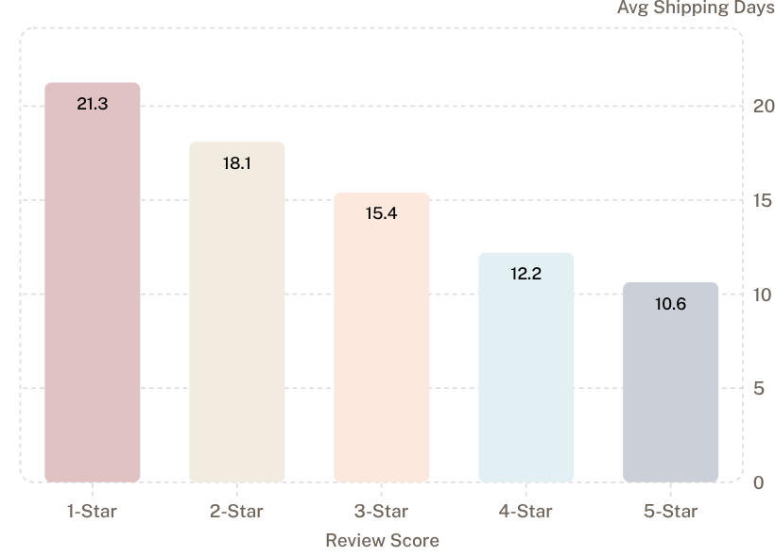
Shipping Days vs Review Score: The Critical Link
What the Data Tells Us
1-star reviews: 21.25 days average shipping
5-star reviews: 10.63 days average shipping
A clear negative relationship — faster shipping drives higher satisfaction
Reducing average shipping time is the single highest-leverage action available to improve review scores at scale.

Slide 9
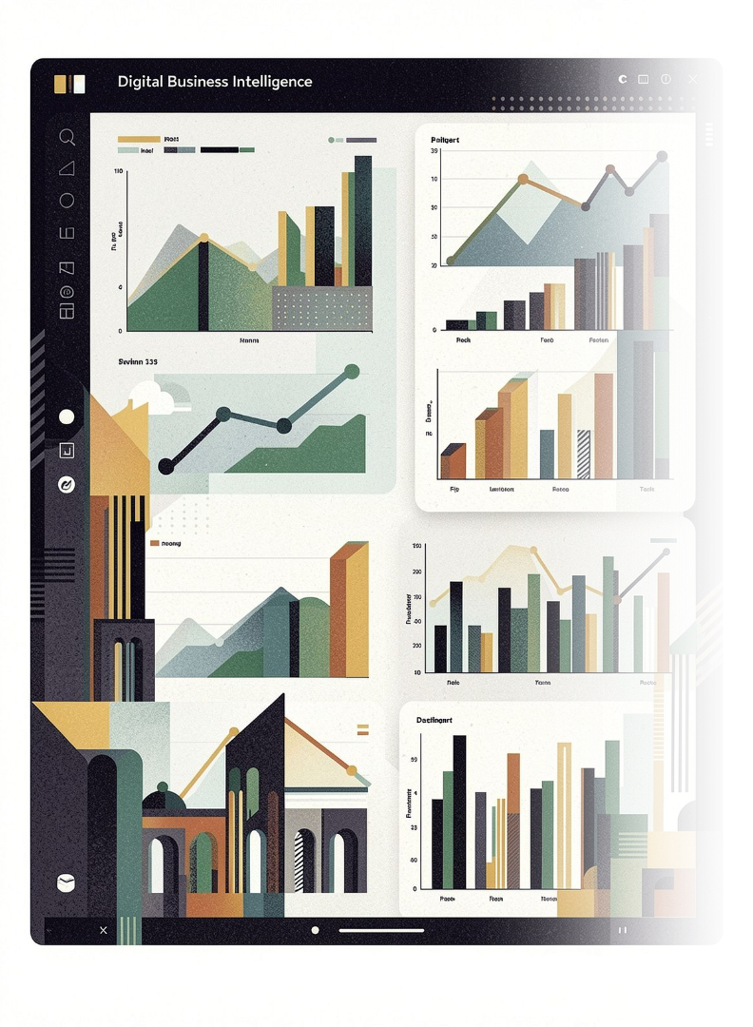
Dashboard Overview
Review Score Distribution
Credit Card Orders broken down by review score segment.
Monthly Sales Trend
Time-series analysis of order volume and revenue over the project period.
Weekday vs Weekend Patterns
Payment method breakdown by transaction timing across all periods.
Shipping vs Satisfaction
Correlation view with interactive filters: Year, Review Score, Delivery Period.

Slide 10
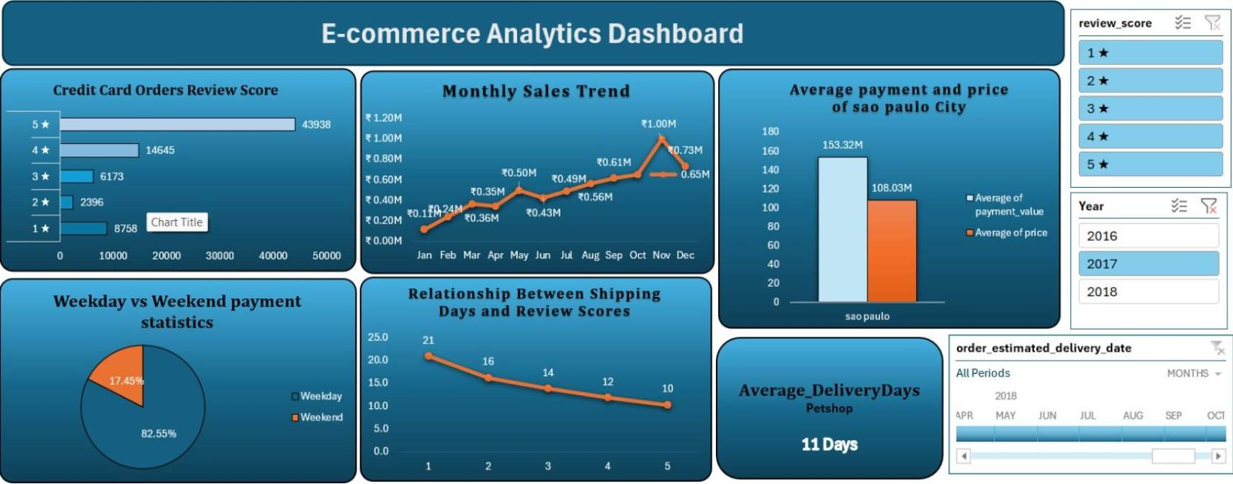
Excel Dashboard
Pivot-table driven analysis with interactive slicers for Review Score, Year, and Delivery Period — built for accessibility across all team skill levels.

Slide 11
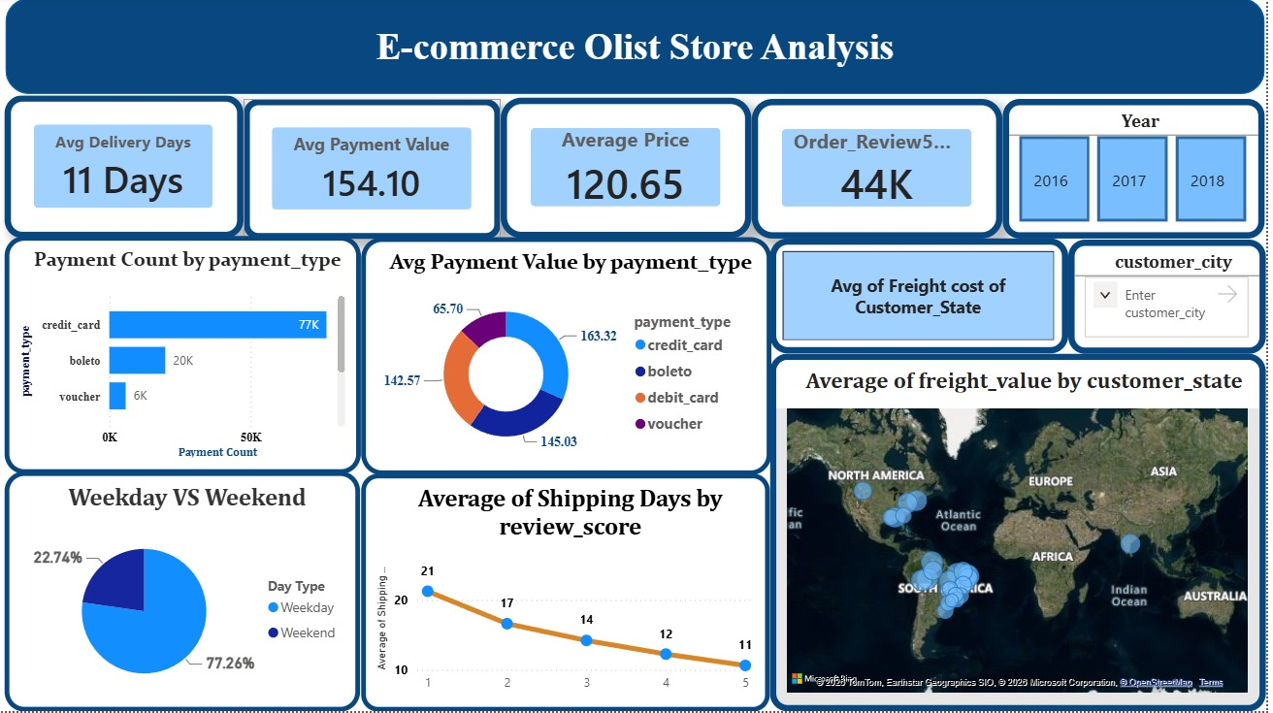
Power BI Dashboard
Live-connected, drill-through enabled dashboard delivering real-time payment, delivery, and satisfaction metrics for operational
and executive reporting.

Slide 12
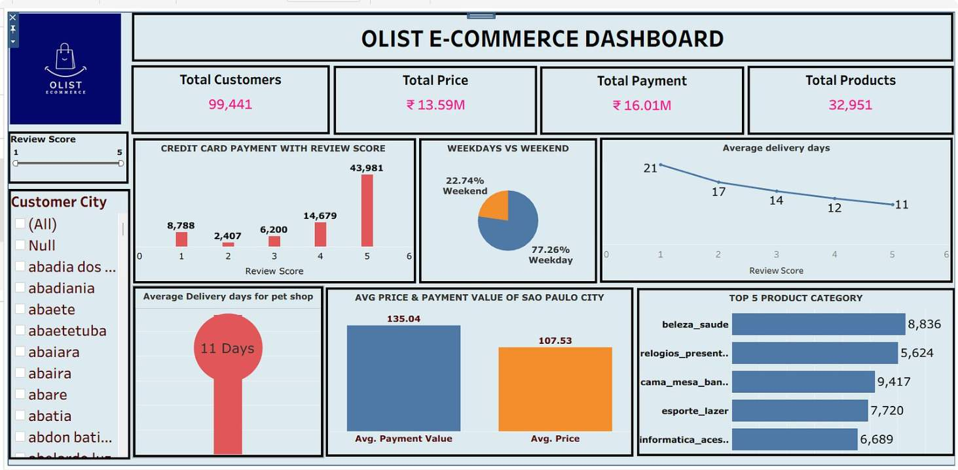
Tableau Dashboard
Visual analytics layer with advanced geographic and trend exploration — designed for deep-dive analytical workflows and presentation-ready storytelling.

Slide 13
Key Findings & Recommendations
1
2
Reduce Shipping Delays
Investigate 1-Star Reviews
Target delivery windows below 11 days to meaningfully shift review scores upward. Shipping time is the highest-leverage operational variable.
Root-cause analysis on the 21+ day delivery cohort to identify systemic service and logistics gaps driving negative sentiment.
3
4
Leverage Payment Preferences
Continuous Performance Monitoring
Design targeted promotions around credit card dominance on weekdays and explore incentive structures to drive weekend volume.
Establish ongoing delivery-to-review correlation tracking across all dashboards to enable proactive intervention before satisfaction dips.

Slide 14
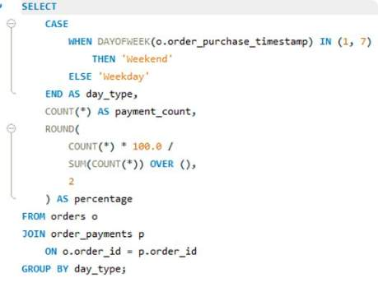
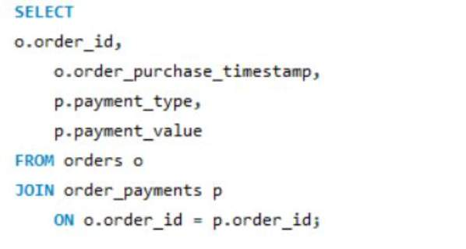
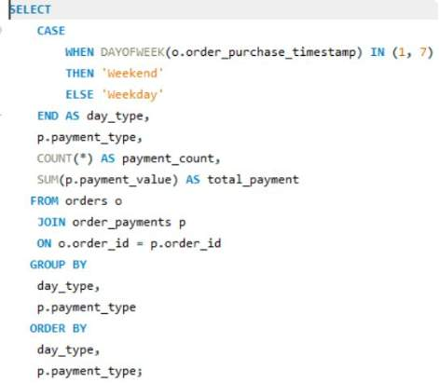
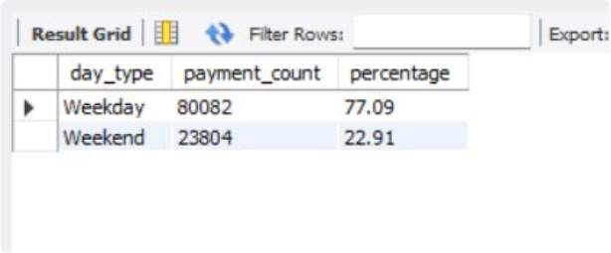
SQL Queries
Q1- Weekday Vs Weekend (order_purchase_timestamp) Payment Statistics
Notes:
need to add Conclusion
Summary

Slide 15
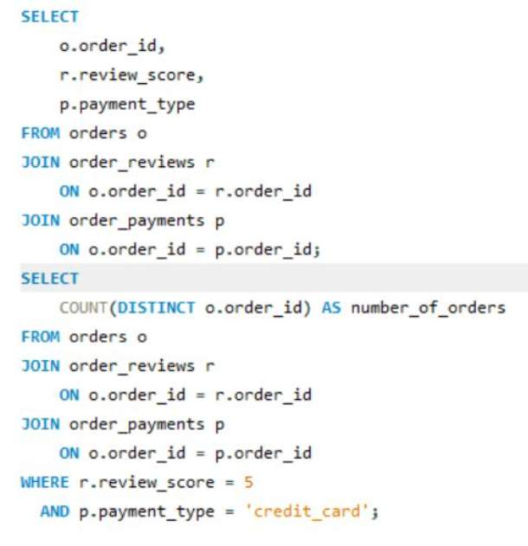
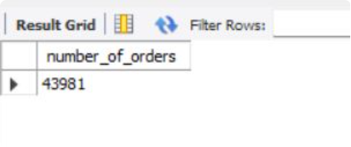
Q2- Number of Orders with review score 5 and payment type as credit card.
Solution-

Slide 16
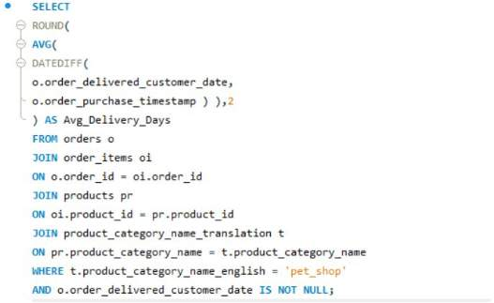
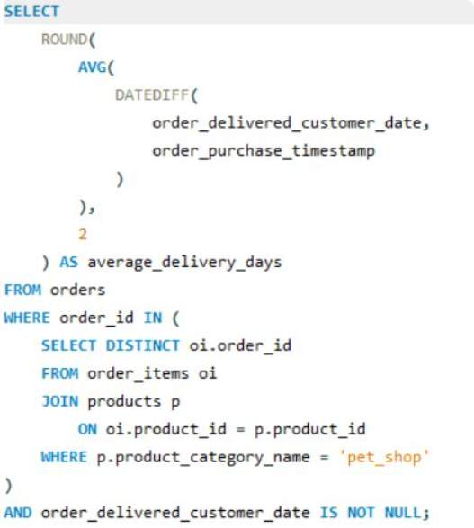
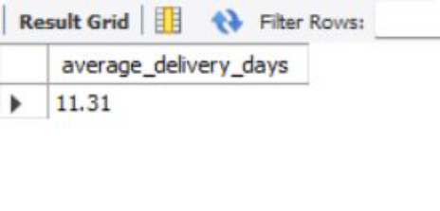
Q3- Average number of days taken for order_delivered_customer_date for pet_shop

Slide 17
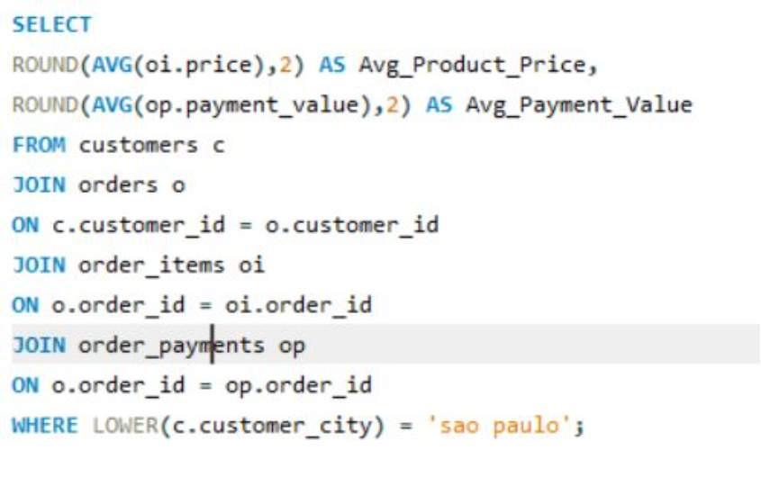
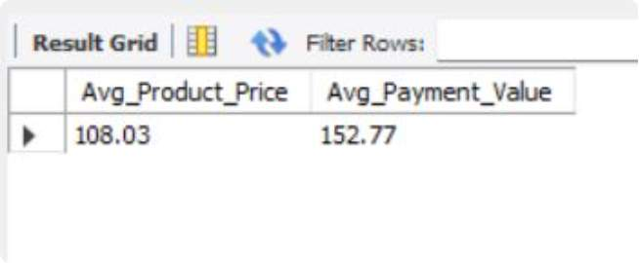
Q4- Average price and payment values from customers of sao paulo city

Slide 18
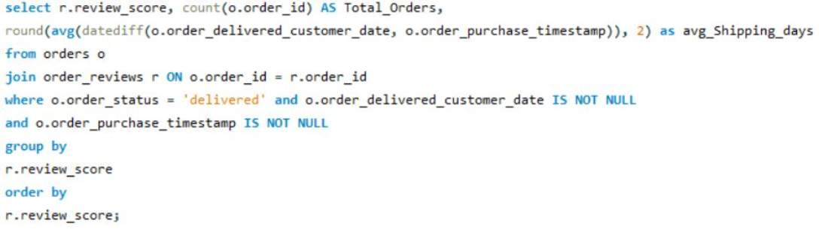
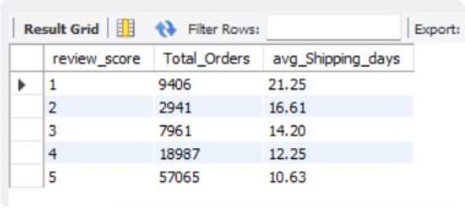
Q5-Relationship between shipping days (order_delivered_customer_date - order_purchase_timestamp) Vs review scores

Slide 19
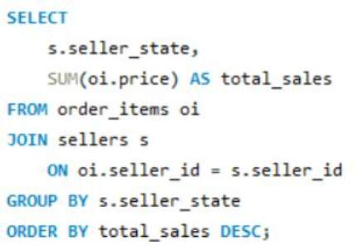
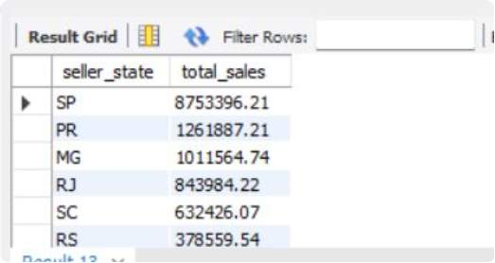
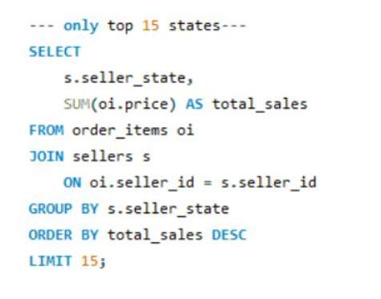
Q7-Which seller states contribute the highest total sales?.

Slide 20
Conclusion
Summary
The analysis shows that delivery performance has a strong impact on customer satisfaction.
Faster shipping is associated with better review scores, while longer delivery times are linked with lower ratings.
Credit card is the dominant payment method, especially on weekdays, showing an opportunity for targeted promotions.
Overall, the dashboards help identify operational areas where improving delivery and customer experience can have the greatest impact.
We analyzed payment behavior, customer reviews, delivery performance, pricing, and sales patterns.
The project was implemented using Excel, Power BI, and Tableau to create interactive dashboards and visual analysis.
The analysis identified key business opportunities such as reducing shipping delays, investigating 1-star reviews, and using payment preferences for promotions.
The final dashboards provide a clear, interactive view of business performance for decision-making.

Slide 21

Thank you !

